Slide 1
Introduction

Slide 2
WHAT IS ECONOMICS?
Economics – the study of how individuals and societies make decisions about ways to use scarce resources to fulfill wants and needs.

Slide 3
Needs and Wants
NEEDS – “stuff” we must have to survive, generally: food, shelter, clothing
WANTS – “stuff” we would really like to have (Fancy food, shelter, clothing, big screen TVs, jewelry, conveniences . . . Also known as LUXURIES

Slide 4
Economic Questions
WHAT to produce (make)
HOW MUCH to produce (quantity)
HOW to Produce it (manufacture)
FOR WHOM to Produce (who gets what)
WHO gets to make these decisions?

Slide 5
Economics
Economics is the science that deals with the production and consumption of goods and services and the distribution and rendering of these for human welfare. The following are the economic goals.
A high level of employment
Price stability
Efficiency
An equitable distribution of income
Growth

Slide 6
Definition of Economics
Economics is the science that deals with the production, consumption, distribution and exchange of wealth.

Slide 7
PRODUCTION, cont.
Production is how much stuff an individual, business, country, even the WORLD makes.
But what is “STUFF”?
STUFF – Goods and Services.
Goods – tangible (you can touch it) products we can buy
Services – work that is performed for others

Slide 8
Factors of Production
So, what do we need to make all of this Stuff?

Slide 9
4 Factors of Production
LAND – Natural Resources
Water, natural gas, oil, trees (all the stuff we find on, in, and under the land)
LABOR – Physical and Intellectual
Labor is manpower
CAPITAL - Tools, Machinery, Factories
The things we use to make things
ENTREPRENEURSHIP – Investment $$$
Investing time, natural resources, labor and capital are all risks associated with production

Slide 10
Production Process
Land
Production/Manufacturing
“Factory”
Goods
Labor
Consumers
Capital
Services
Entrepreneurship

Slide 11
Consumption
The part of wealth used to fulfill the basic needs of human life is called consumption. We spent our income in that direction from where we can derive maximum utility.

Slide 12
Distribution
How the four factors are paid according to their contribution in the form of rent, wages, interest and profit.

Slide 13
Exchange of wealth
How the wealth exchanged from one hand to another. And similarly how wealth is exchanged between the two countries in the form of trade.

Slide 14
So, we can say that
“Economics is the study of how people and society choose to employ scarce resources that could have alternative uses in order to produce various commodities and to distribute them for consumption, now or in the future, …”

Slide 15
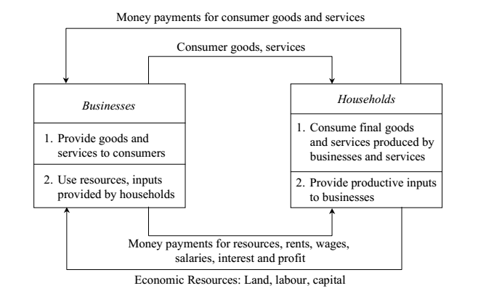
Flow in an Economy 2 Sector Economy

Slide 16
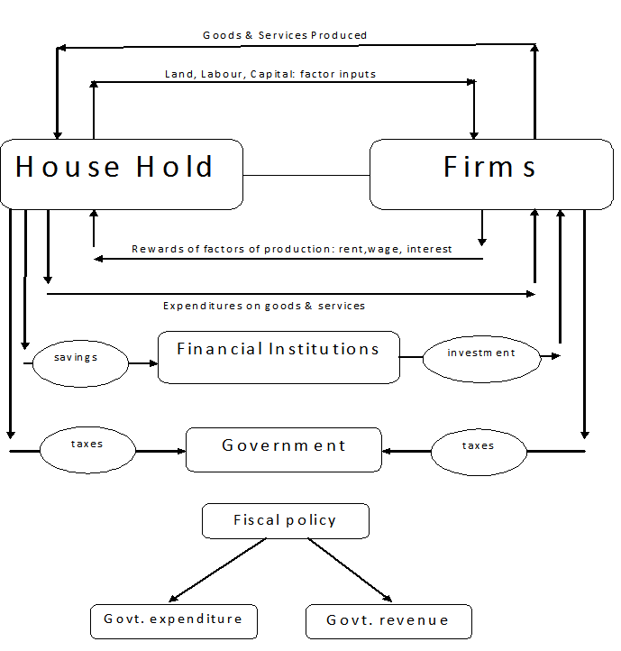
Flow in an Economy 3 Sector Economy

Slide 17
Micro Economics
Micro economics studies the decisions made by individual and business concerning the distribution of resources and prices of goods and services.
It deals with a specific industry or a sector, the connections of firms and households in the market.
For example, microeconomics would study how a company could lower its prices to increase its product demand in the market.

Slide 18
It deals with the decision making of single economic variables such as the demand, price, consumer, etc.

Slide 19
Macro Economics
Macroeconomics, studies the behavior of not only particular company or industries but whole economy.
It includes understanding how unemployment, price levels, growth rate affects the economy wide aspects such as the Gross National Product (GNP).
It deals with averages and aggregates of the entire economy such as national income, aggregate output, aggregate savings etc.

Slide 20
Demand

Slide 21
Demand means wish or desire to have commodity
Two things must be fulfilled for existence of demand
Will to purchase any thing
Power to purchase a commodity
Another important thing is
Price

Slide 22
As any change in the price of a good results a certain change in the demand for that good
Thus
qd= f(P)
“Demand is the quantity of a commodity which the consumers are prepared to purchase at a certain price during a specific period of time”.

Slide 23
Types of demand
There are three types of demand
Price demand
Income demand
Cross demand

Slide 24
Price demand
It refers to the various quantities of a commodity or service that a consumer would purchase at a given time in a market at a various prices.
It is assumed that other things such as consumer’s income, tastes and prices of interrelated goods remain unchanged.

Slide 25
Income demand
It refers to the various quantities of a commodity or service which would be purchased by a consumer at various level of income.
It is assumed that other things such as price, tastes and desire of consumer do not change.

Slide 26
Cross demand
It refers to the various quantities of a commodity or service which will be purchased with reference to change in the price not of this good but of other interrelated goods.
These goods are either substitutes or complementary goods.

Slide 27
Law of demand
It can be defined as the functional relationship between price and quantity demanded.
There is inverse relationship between the price of commodity and its demand, as:
Price ↑ than quantity of demand↓
Price ↓ than quantity of demand ↑

Slide 28
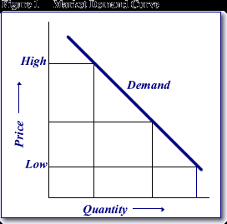

Slide 29
Factors influencing demand
The shape of the demand curve is influenced by the following factors:
Income of the people
Prices of related goods
Tastes of consumers

Slide 30
Assumptions of law of demand
No change in the number of consumer
No change in the consumer’s income
No change in the consumer’s fashion, taste and habits
No change in the price of substitutes
No change in the external value of money

Slide 31
Limitation
Under certain circumstances the prices and the demand of commodity move in the same direction. These are known as limitation/ exception of law of demand
Giffon goods (inferior goods)
Scare goods (scarcity of supply of commodity in future)
The most precious goods
Emergency
Ignorance and carelessness

Slide 32
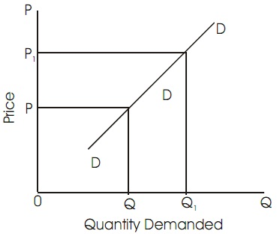
It is positively sloped as Price ↑ than quantity of demand ↑ Price ↓ than quantity of demand ↓

Slide 33
This behavior of consumer is called as “law of demand”.
“There is an inverse relationship between the quantity demanded and the price of the commodity, with the condition that the income of the consumers and prices of substitutes remaining unchanged”.

Slide 34
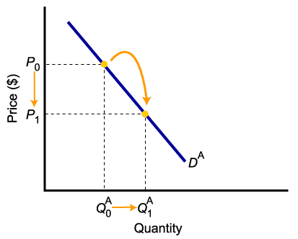
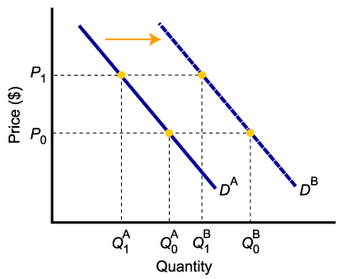
A movement in Demand curve Versus a shift of Demand curve
Change in price of a good or service
leads to
Change in quantity demanded (Movement along the curve).
Change in income, preferences, or prices of other goods or services
leads to
Change in demand (Shift of curve).

Slide 35
SUPPLY
Supply of a commodity means quantity of the commodity which is actually offered for sale at a given price during some particular time.
The definition of supply is complete when it has the following elements: (i) Quantity of a commodity offered for sale; (ii) Price of the commodity; and (iii) Time during which the quantity is offered.

Slide 36
THE LAW OF SUPPLY
‘Law of supply states that other things remaining the same, the quantity of any commodity that firms will produce and offer for sale rises with rise in price and falls with fall in price.’
Higher the price, higher will be quantity supplied and lower the price smaller will be quantity supplied.
‘Other things remaining the same’ means determinants other than own price such as technology, goals of the firm, government policy, price of related goods etc. should not change.

Slide 37
The Supply Curve
The supply curve is the graphic representation of the law of supply.
The supply curve slopes upward to the right.
The slope tells us that the quantity supplied varies directly – in the same direction – with the price.

Slide 38
A Sample Supply Curve
S
Price (per unit)
A
P_{A}
0
Q_{A}
Quantity supplied (per unit of time)

Slide 39
Assumptions
Prices of factors of production do not change
Do not change in technology
Government taxes do not change
Weather do not change

Slide 40
Limitations
War period
Need for money
Future fear
Transferability

Slide 41
FACTORS DETERMINING SUPPLY
Price of the commodity;
Price of related goods;
State of technology;
Cost of production; and
Government policy.

Slide 42
CHANGE IN QUANTITY SUPPLIED (MOVEMENT): Expansion or Contraction of supply
A movement along the supply curve is caused by changes in the price of the good, other things remaining constant. It is also called change in quantity supplied of the commodity.
Movement along the supply curve is of two types: 1) Expansion of supply, and 2) contraction of supply.

Slide 43
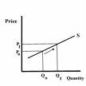
1) Expansion or Extraction of Supply: - When the quantity supplied rise due to rise in the price, it is extension of supply or increase in quantity supplied. - Here the supply curve moves upward. - It is due to increase in price.

Slide 44
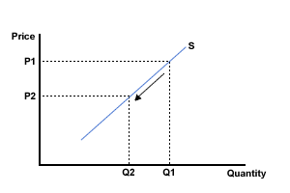
2) Contraction of supply: - When the quantity supplied falls due to a fall in its price, it is called contraction of supply or decrease in quantity supplied. - In this case supply curve moves downwards. - It is due to decrease in price.

Slide 45
CHANGE IN SUPPLY (SHIFT): Increase or Decrease in Supply
A shift in supply curve is caused by changes in factors other than the price of good.
These factors are: a) State of technology b) Cost of production c) Government policy

Slide 46
A change in any of these factors causes shift in the supply curve. It is also called change in supply.
In a shift, a new supply curve is drawn.
A shift of the supply curve can be of two types: 1) Increase in supply, or 2) Decrease in supply

Slide 47
Increase in supply: -when supply of a commodity rises due to favorable changes in factors other than price of the commodity, it is called increase in supply.
- Favorable changes imply: (i) Improvement in technique of production (ii) Fall in the cost of production (iii) Fall in taxes

Slide 48
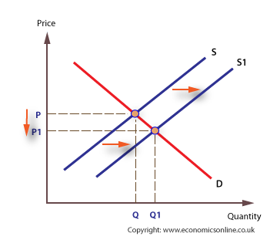

Slide 49
2) Decrease in supply: -When supply of a commodity falls due to unfavorable changes in factors other than its price, it is called decrease in supply.
-The causes of decrease in supply are: (i) outdated technique of production (ii) Increase in the cost of production (iii) Rise in tax

Slide 50
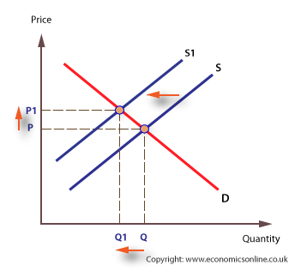

Slide 51
Market Equilibrium
The operation of the market depends on the interaction between buyers and sellers.
An equilibrium is the condition that exists when quantity supplied and quantity demanded are equal.
At equilibrium, there is no tendency for the market price to change.

Slide 52
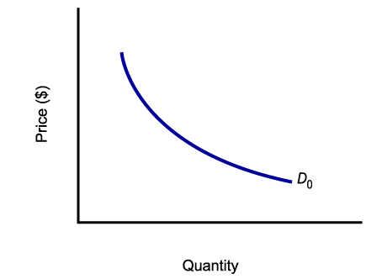
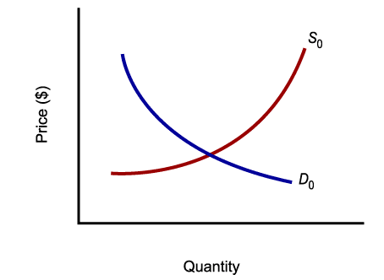
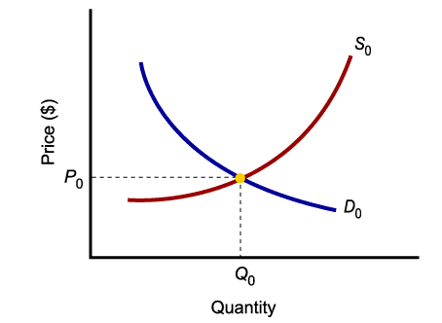
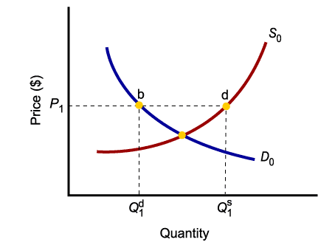
Market Equilibrium
Only in equilibrium is quantity supplied equal to quantity demanded.
At any price level other than P₀, the wishes of buyers and sellers do not coincide.

Slide 53
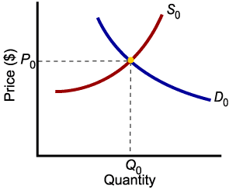
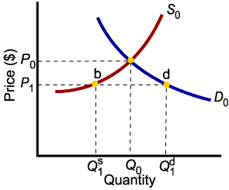
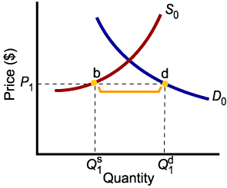
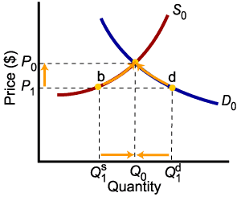
Market Disequilibria
Excess demand, or shortage, is the condition that exists when quantity demanded exceeds quantity supplied at the current price.
When quantity demanded exceeds quantity supplied, price tends to rise until equilibrium is restored.

Slide 54
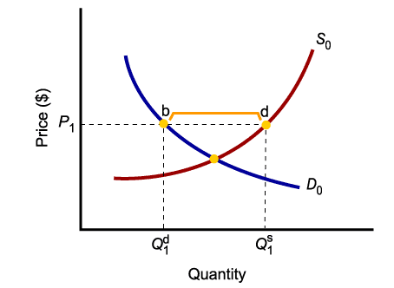
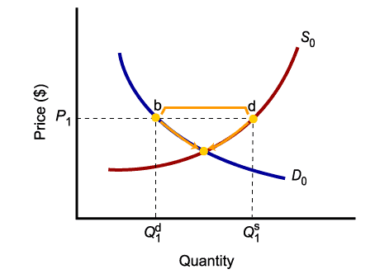
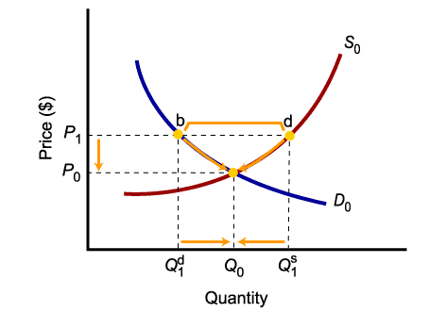
Market Disequilibria
Excess supply, or surplus, is the condition that exists when quantity supplied exceeds quantity demanded at the current price.
When quantity supplied exceeds quantity demanded, price tends to fall until equilibrium is restored.

Slide 55
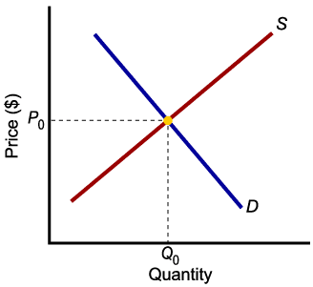
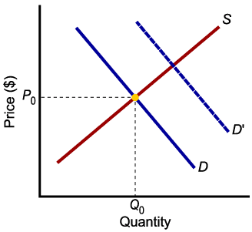
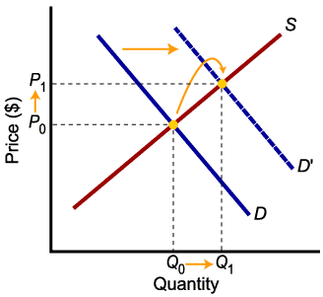

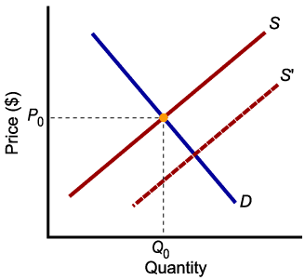
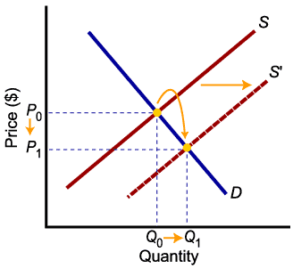
Increases in Demand and Supply
Higher demand leads to higher equilibrium price and higher equilibrium quantity.
Higher supply leads to lower equilibrium price and higher equilibrium quantity.

Slide 56

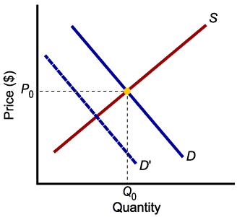
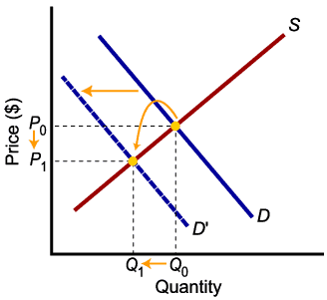

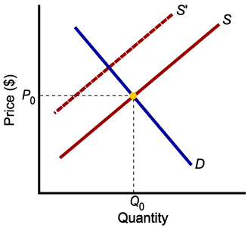
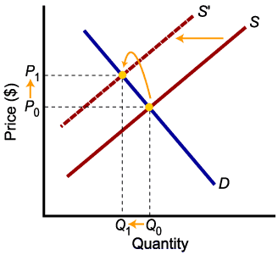
Decreases in Demand and Supply
Lower demand leads to lower price and lower quantity exchanged.
Lower supply leads to higher price and lower quantity exchanged.

Slide 57
Efficiency

Slide 58
Types of Efficiency
Efficiency of a system is generally defined as the ratio of its output to input.
The efficiency can be classified into:
Technical efficiency and
Economic efficiency.

Slide 59


Technical efficiency
It is the ratio of the output to input of a physical system. The physical system may be a diesel engine, a machine working in a shop floor, a furnace, etc.
The technical efficiency of a diesel engine is as follows:

Slide 60

Economic efficiency
Economic efficiency is the ratio of output to input of a business system.
‘Worth’ is the annual revenue generated by way of operating the business and
‘cost’ is the total annual expenses incurred in carrying out the business.

Slide 61
How to improve economic efficiency?
Economic efficiency is also called ‘productivity’. There are several ways of improving productivity .
Increased output for the same input
Decreased input for the same output
By a proportionate increase in the output which is more than the proportionate increase in the input
By a proportionate decrease in the input which is more than the proportionate decrease in the output
Through simultaneous increase in the output with decrease in the input

Slide 62
Improved output for the same input In this strategy, the output is increased while keeping the input constant. Let us assume that in a steel plant, the layout of the existing facilities is not proper. By slightly altering the location of the billet-making section, and bringing it closer to the furnace which produces hot metal, the scale formation at the top of ladles will be considerably reduced. The molten metal is usually carried in ladles to the billet-making section. In the long run, this would give more yield in terms of tonnes of billet produced. In this exercise, there is no extra cost involved. The only task is the relocation of the billet-making facility which involves an insignificant cost.

Slide 63
Decreased input for the same output
In this strategy, the input is decreased to produce the same output. Let us assume that there exists a substitute raw material to manufacture a product and it is available at a lower price. If we can identify such a material and use it for manufacturing the product, then certainly it will reduce the input. In this exercise, the job of the purchase department is to identify an alternate substitute material. The process of identification does not involve any extra cost. So, the productivity ratio will increase because of the decreased input by way of using cheaper raw materials to produce the same output.

Slide 64
By a proportionate increase in the output which is more than the proportionate increase in the input (Consider the example of introducing a new product into the existing product mix of an organization). Let us assume that the existing facilities are not fully utilized and the R&D wing of the company has identified a new product which has a very good market and which can be manufactured with the surplus facilities of the organization. If the new product is taken up for production, it will lead to—
an increase in the revenue of the organization by way of selling the new product in addition to the existing product mix and
an increase in the material cost and operation and maintenance cost of machineries because of producing the new product.
If we examine these two increases closely, the proportionate increase in the revenue will be more than the proportionate increase in the input cost. Hence, there will be a net increase in the productivity ratio.

Slide 65
By a proportionate decrease in the input which is more than the proportionate decrease in the output (Let us consider the converse of the previous example, i.e. dropping an uneconomical product from the existing product mix. This will result in the following:
A decrease in the revenue of the organization
A decrease in the material cost, and operation and maintenance cost of machinery
If we closely examine these two decreases, we will see that the proportionate decrease in the input cost will be more than the proportionate decrease in the revenue. Hence, there will be a net increase in the productivity ratio.

Slide 66
Through simultaneous increase in the output with decrease in the input. (Let us assume that there are advanced automated technologies like robots and automated guided vehicle system (AGVS), available in the market which can be employed in the organization we are interested in.
If we employ these modern tools, then:
There will be a drastic reduction in the operation cost. Initially, the cost on equipment would be very high. But, in the long run, the reduction in the operation cost would break-even the high initial investment and offer more savings on the input.
These advanced facilities would help in producing more products because they do not experience fatigue. The increased production will yield more revenue. In this example, in the long run, there is an increase in the revenue and a decrease in the input. Hence, the productivity ratio will increase at a faster rate.

Slide 67
Definition and Scope of Engineering Economics
Definition
Engineering economics deals with the methods that enable one to take economic decisions towards minimizing costs and/or maximizing benefits to business organizations.

Slide 68
Scope
The issues that are covered in this course are
elementary economic analysis,
interest formulae,
bases for comparing alternatives,
present worth method, future worth method,
annual equivalent method,
rate of return method,
replacement analysis,
depreciation,
Inflation
inventory control, etc.

